Slide 1
Properties
Srikar Mylavarapu

Slide 2
Questions from last week
None of note

Slide 3
Parameterless Properties
Problem 1
Not encapsulating
Allow unconstrained behavior
Problem 2
Becomes kind of unwieldy
‘boilerplate’
How do other languages do the exact same thing
- If we look at getters and setter in Java, it’s the ‘same thing’

Slide 4
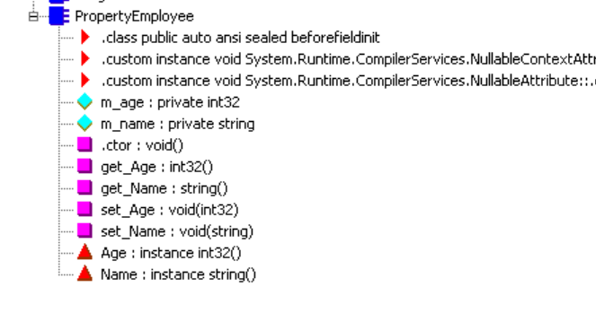
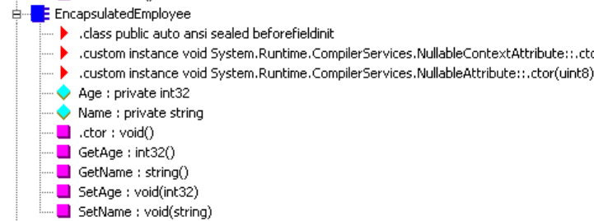
A property will get: getter and/or setter (see purple) and red triangle property definition

Slide 5
Lombok
Lombok is a type of chili
Basically, in Java, we’d have a lot of boiler plate for the same thing
Good and bad part about this?
Think about order

Slide 6
Properties of properties
Can’t overload
‘smart fields with additional logic behind them

